Slide 1
ABM handoff

Slide 2
Contents
The grandiose plans
The reality so far
ABM overview and details
Visualizing output
Pattern matching

Slide 3
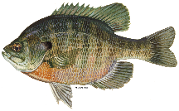
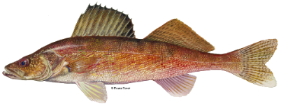
Forecasting angler responses to slow environmental change
Past (1980-2000) | Recent past (2000-2020) | Future (2020-2050)
Groundtruthing: walleye and bluegill fishing effort, walleye populations, exploitation
Forecasting: No walleye stocking
Forecasting: Yes walleye stocking
Prob. Walleye recruitment failure
Growth
Age at maturity
Natural mortality
Notes:
This is how I was imagining the ABM could be used first, to groundtruth the simulation versus existing data on fishing effort, walleye populations, exploitation rates, then look at short term forecasts based on lake temperature and its effects on M and growth
The idea would then be to run replicates of these simulations for different climate scenarios, bringing in USGS model-based estimates of lake water temperatures for different past, present, and future time periods. As the scenarios progress, we would be able to see the influences of increased bluegill growth, as well as the negative effects of warmer waters on walleye populations. There then would be the option to test the effects of management interventions like stocking on landscape-scale outcomes. This relies on some other work that is happening on bluegill (ask Zach about this)

Slide 4
Catchability paper
A. Catchability: partitioning variance btw lake, environmental conditions, angler identity
WDNR creel data
FishScapes experimental angling
SES paper 1: model validation and climate scenarios
C. IBM
(Provides catchability estimates/distributions)
(Informing catchability)
B. Angler decisions: Revealed preference analysis of participation, species choice, and travel vs. expected catch
Revealed preference paper: choice model
WDNR angler diaries
FishScapes creel surveys
(Informing angler decisions)
(Have 1 year of angler diaries; more exist)
(Provides unsurveyed PE)
(Pattern testing)
GLMM-predicted walleye population estimates (Hansen et al 2015 NAJFM)
Data
Analysis
Simulation
Product
(Don’t yet have access—who to contact?)
Notes:
This was my plan—developing angler choice and catch submodels based on analysis of revealed preference data and an experimental angling dataset. I managed A (partitioning variance, in prep). DCE didn’t pan out, revealed preference never got off the ground

Slide 5
SES model: possible endpoint
From diary analysis:
For each of N lakes:
Angler choice (Fishing, not fishing)
Influence M and growth
Walleye population model
Target selection, catch and harvest
Climate effects on lake temperatures
Angler choice (Bluegill, walleye, something else)
Bluegill population model
From diary and DCE:
Angler memory, info sharing, and expectations
Angler choice (Lake)
Future opportunities:
Add LMB populations and:
Distance from angler
Observation model
Manager decisions
Notes:
This is the model that we are eventually shooting for: where each of the lakes in the simulation can include bluegill as an alternative target species. And in different climate scenarios, differences in lake temperature would drive differences among lakes in growth and natural mortality. Anglers then act on these lakes, choosing lakes, target species, and then catching and harvesting fish. Their experience at different lakes would then be remembered, and used as updated information for their next decision. For this more interesting angler choice model, I’m going to use utility estimates from a choice experiment that’s already been completed, as well as an analysis of angler diary data collected by the DNR. The diary analysis will inform simulated anglers’ decisions to participate (or not), choose to fish for bluegill, walleye, or something else, and then choose a lake. In further future iterations, I’d like to add a manager decision sub-model that observes the fishery landscape with error and then makes intervention decisions.

Slide 6
For each of N lakes:
Walleye population model
Harvest walleye
Angler choice (Lake)
Distance from angler
Notes:
This is the model that we are eventually shooting for: where each of the lakes in the simulation can include bluegill as an alternative target species. And in different climate scenarios, differences in lake temperature would drive differences among lakes in growth and natural mortality. Anglers then act on these lakes, choosing lakes, target species, and then catching and harvesting fish. Their experience at different lakes would then be remembered, and used as updated information for their next decision. For this more interesting angler choice model, I’m going to use utility estimates from a choice experiment that’s already been completed, as well as an analysis of angler diary data collected by the DNR. The diary analysis will inform simulated anglers’ decisions to participate (or not), choose to fish for bluegill, walleye, or something else, and then choose a lake. In further future iterations, I’d like to add a manager decision sub-model that observes the fishery landscape with error and then makes intervention decisions.

Slide 7
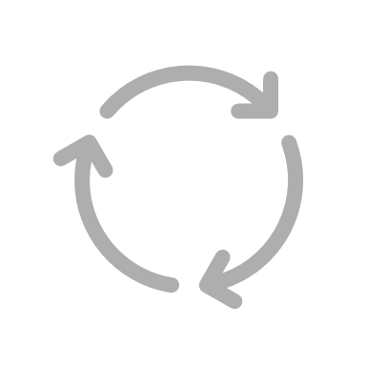

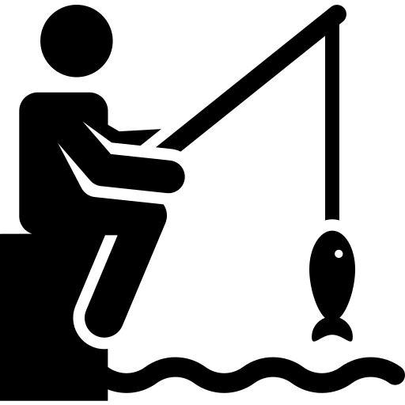

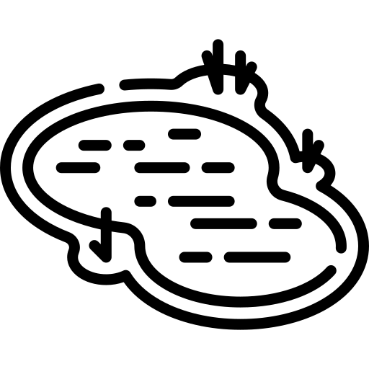
Individual-based model of the WI inland recreational fishery
Angler diaries
Choice experiment
Creel survey data
Electrofishing surveys
Walleye pop dy research
Notes:
To proactively identify potential large-scale responses to this change, we are developing an individual-based model integrating biological and social data. The model has three main components: 1) A decision model parameterized by angler diaries and a choice experiment where anglers choose among fishing sites, 2) A fishing model, where anglers harvest fish at their chosen site, and 3) a biological model of fish populations. Currently this is walleye only, and parameterized by DNR survey data and a large body of walleye population dynamics research. We are trying to find the simplest possible model that can produce landscape-scale patterns in fishing effort and harvest corresponding to observed patterns.

Slide 8
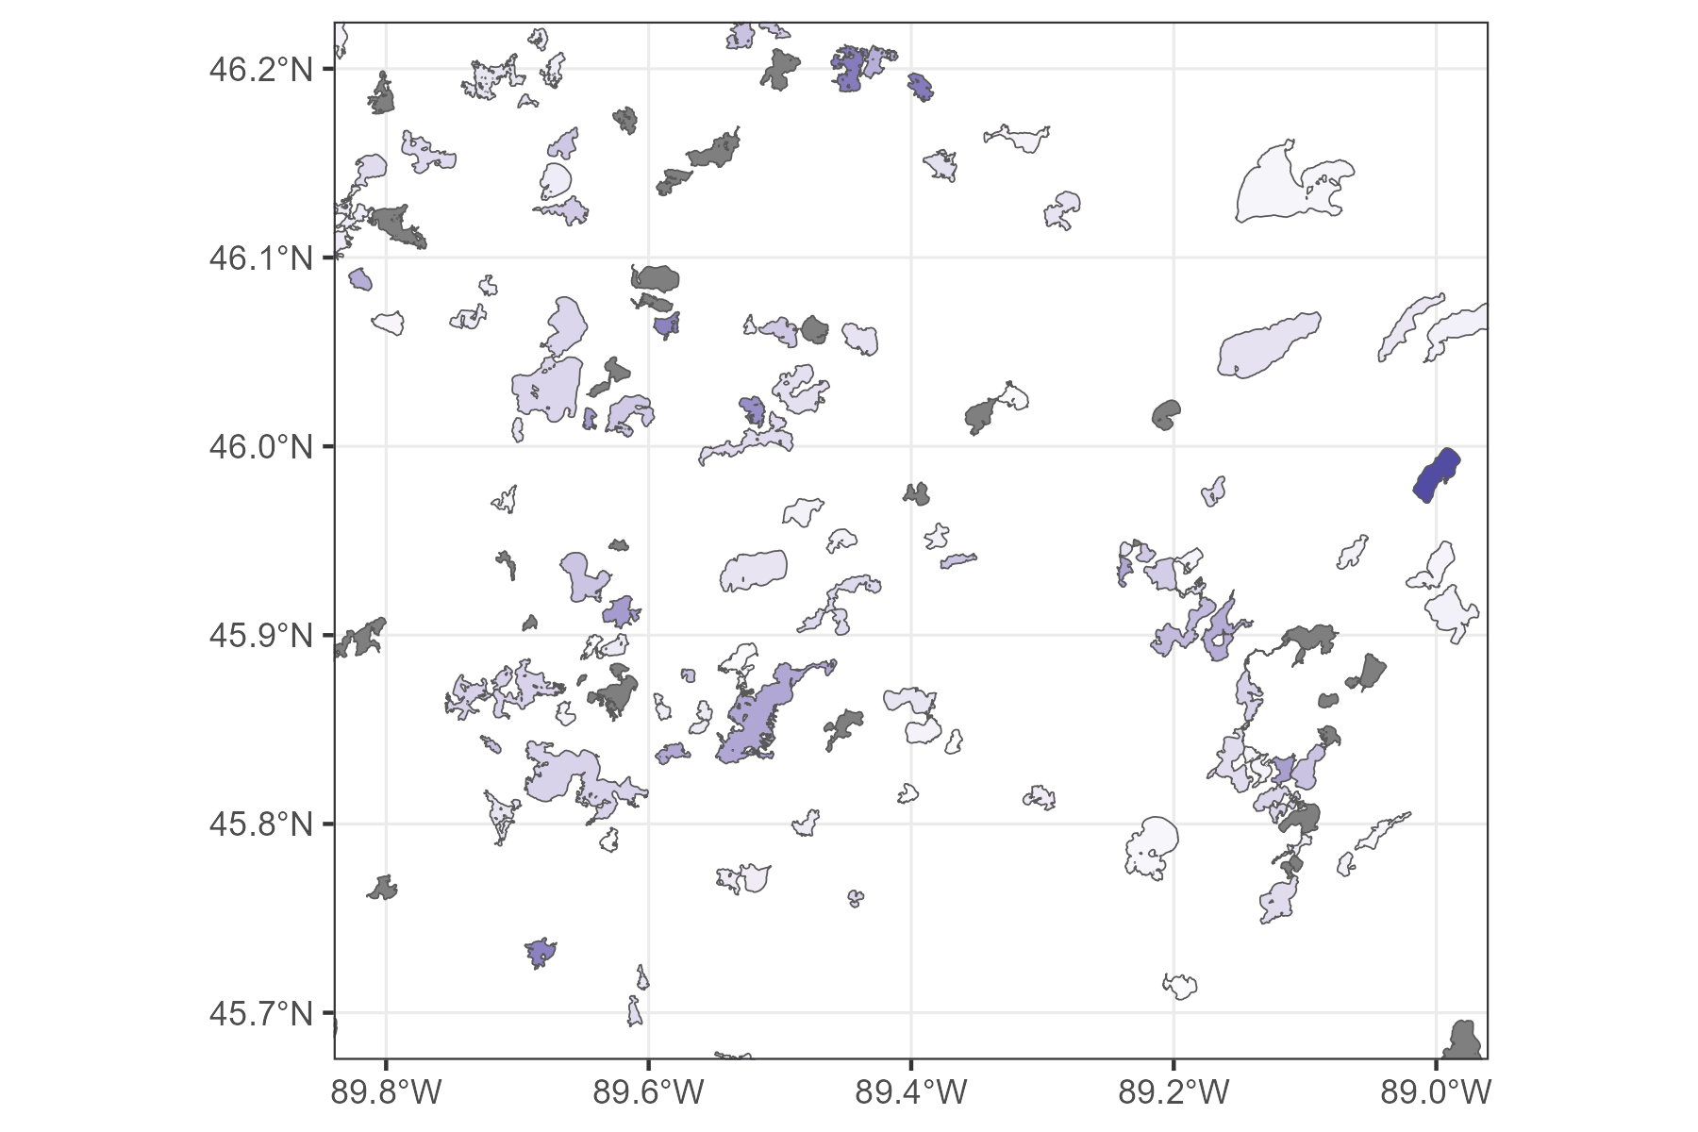


Choice probability ~
distance
walleye population
Notes:
This model is spatially explicit and based on a selection of real WI lakes. For now these are lakes with creel and fish population data collected by the DNR, and I show a selection of them here. Anglers are assigned a home location with some known distance to each lake included in the model. This map shows some of those lakes and a few arbitrary example angler locations. In each loop of the daily model, anglers currently weight distance and walleye population abundance to choose a fishing site.

Slide 9


$$\frac{C}{E}=qN^{β}$$
Notes:
They then harvest walleye from that lake based on the catch equation with hyperstability, removing walleye from the population.

Slide 10
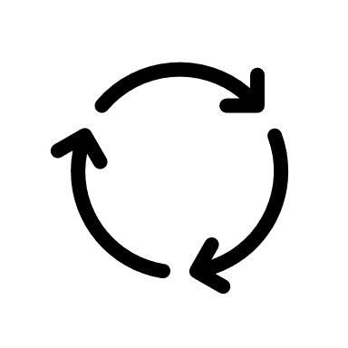
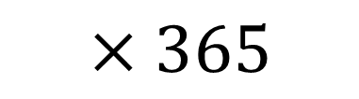
$$×365$$
Notes:
This cycle then repeats for a year.

Slide 11

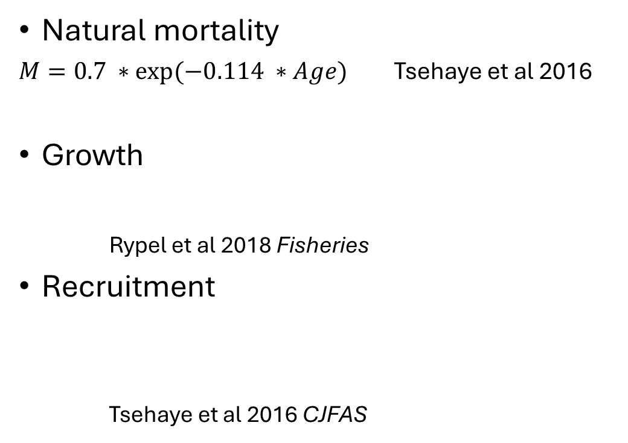



Each annual loop:
Natural mortality
$M=0.7 ∗exp⁡(−0.114 ∗Age)$ Tsehaye et al 2016
Growth
Rypel et al 2018 Fisheries
Recruitment
Tsehaye et al 2016 CJFAS
$$M_{adj}=0.7−0.92×\frac{N harvest}{N vulnerable}×M$$
M. Hansen et al 2011
$$L=L_{inf}×e^{−k(age−t0)}$$
$$R= αSe^{β}×e^{ω}$$
$$ω\sim N(0,σ^{2})$$
Notes:
After each year of the simulation, the fish populations of each lake then experience natural mortality, ageing and growth, and recruitment. In this simple version, we have constant natural mortality, growth that is based on lake classification published by Andrew Rypel and colleagues, and a deterministic Ricker stock recruitment curve using regional parameters estimated by Iyob Tsehaye and coauthors.

Slide 12
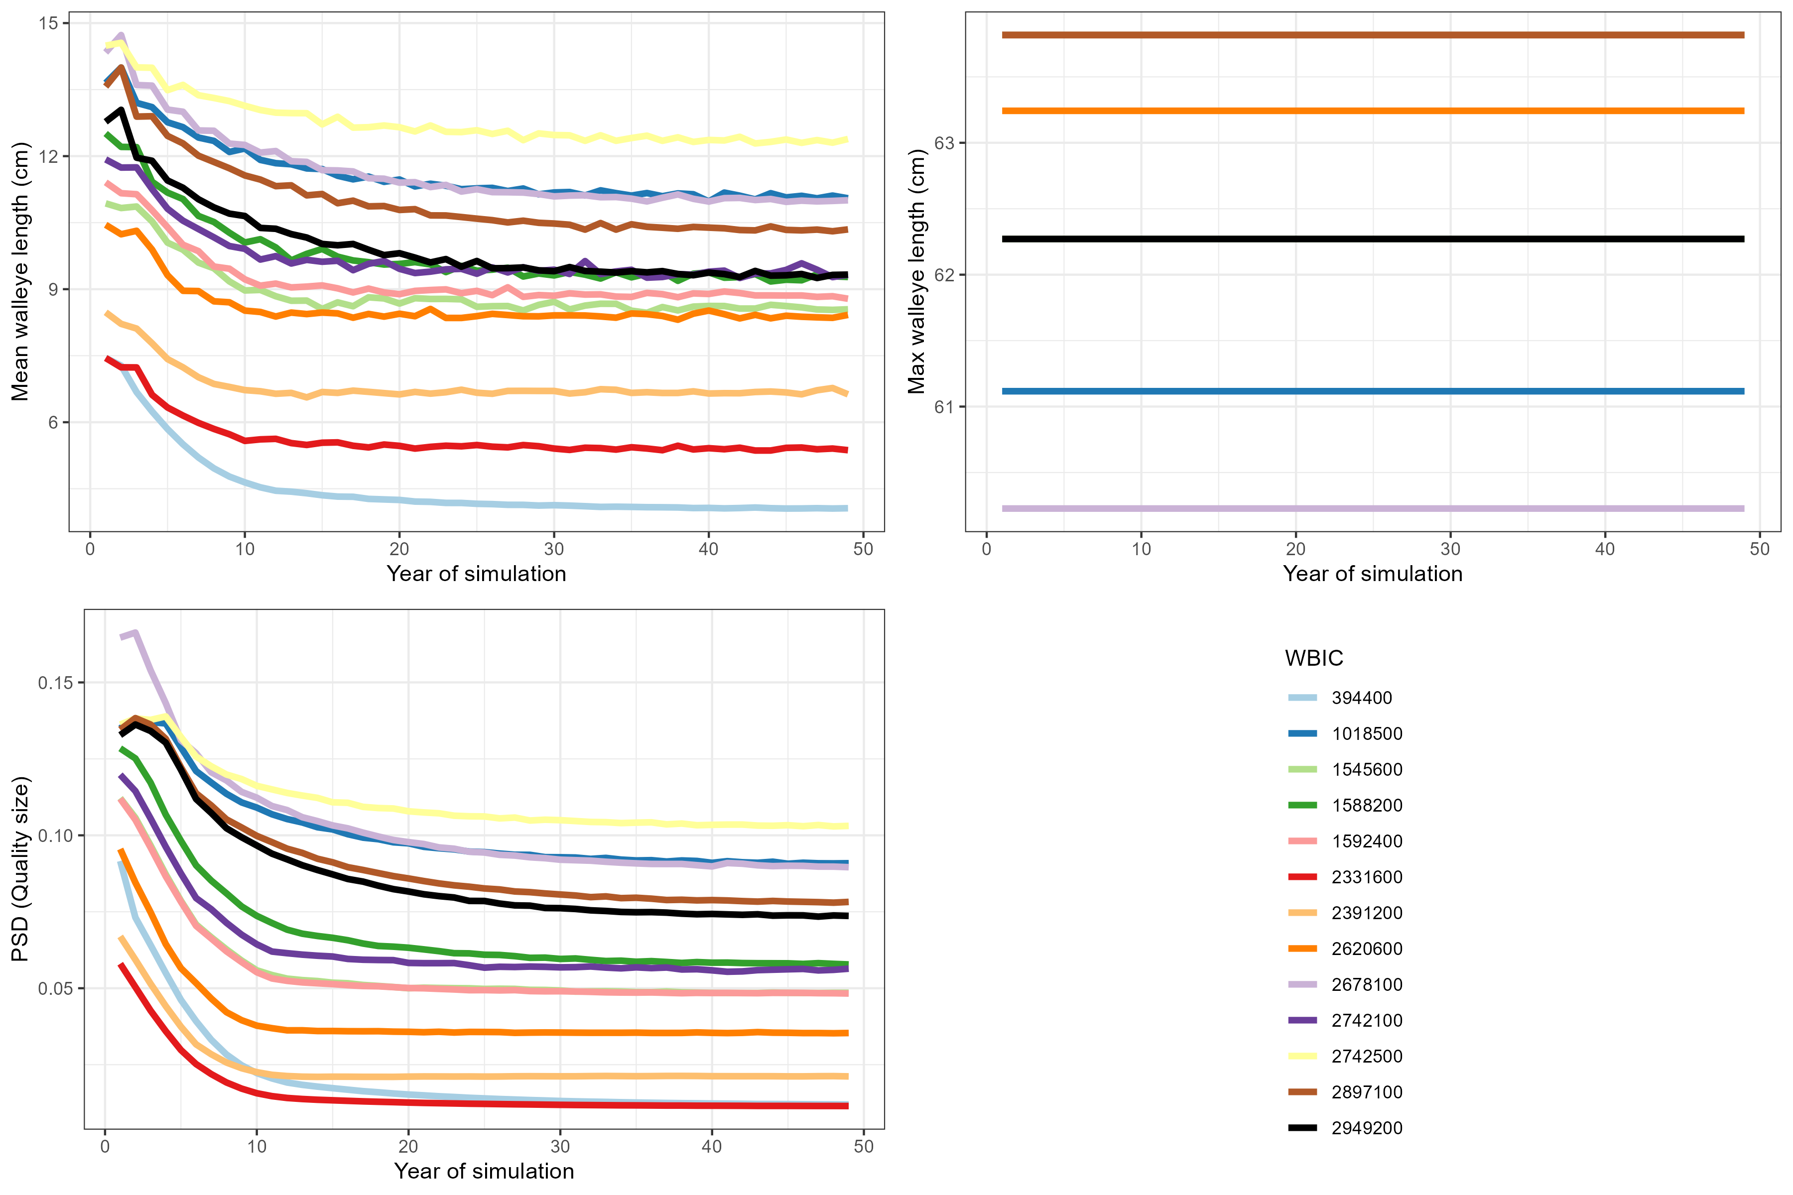
Mean walleye length (cm)
Max walleye length (cm)
PSD (quality)
Notes:
These are all different summaries of size structure: mean length, max length, and PSD quality size. In the mean and PSD plots, we can see the expected decline in size structure that you would expect from high fishing effort. The max size is looking less useful; I think this is because I included a maximum of 15 year classes, with 15+ survivors just remaining there and not growing. This tells me that those old fish aren’t going away in this scenario.

Slide 13
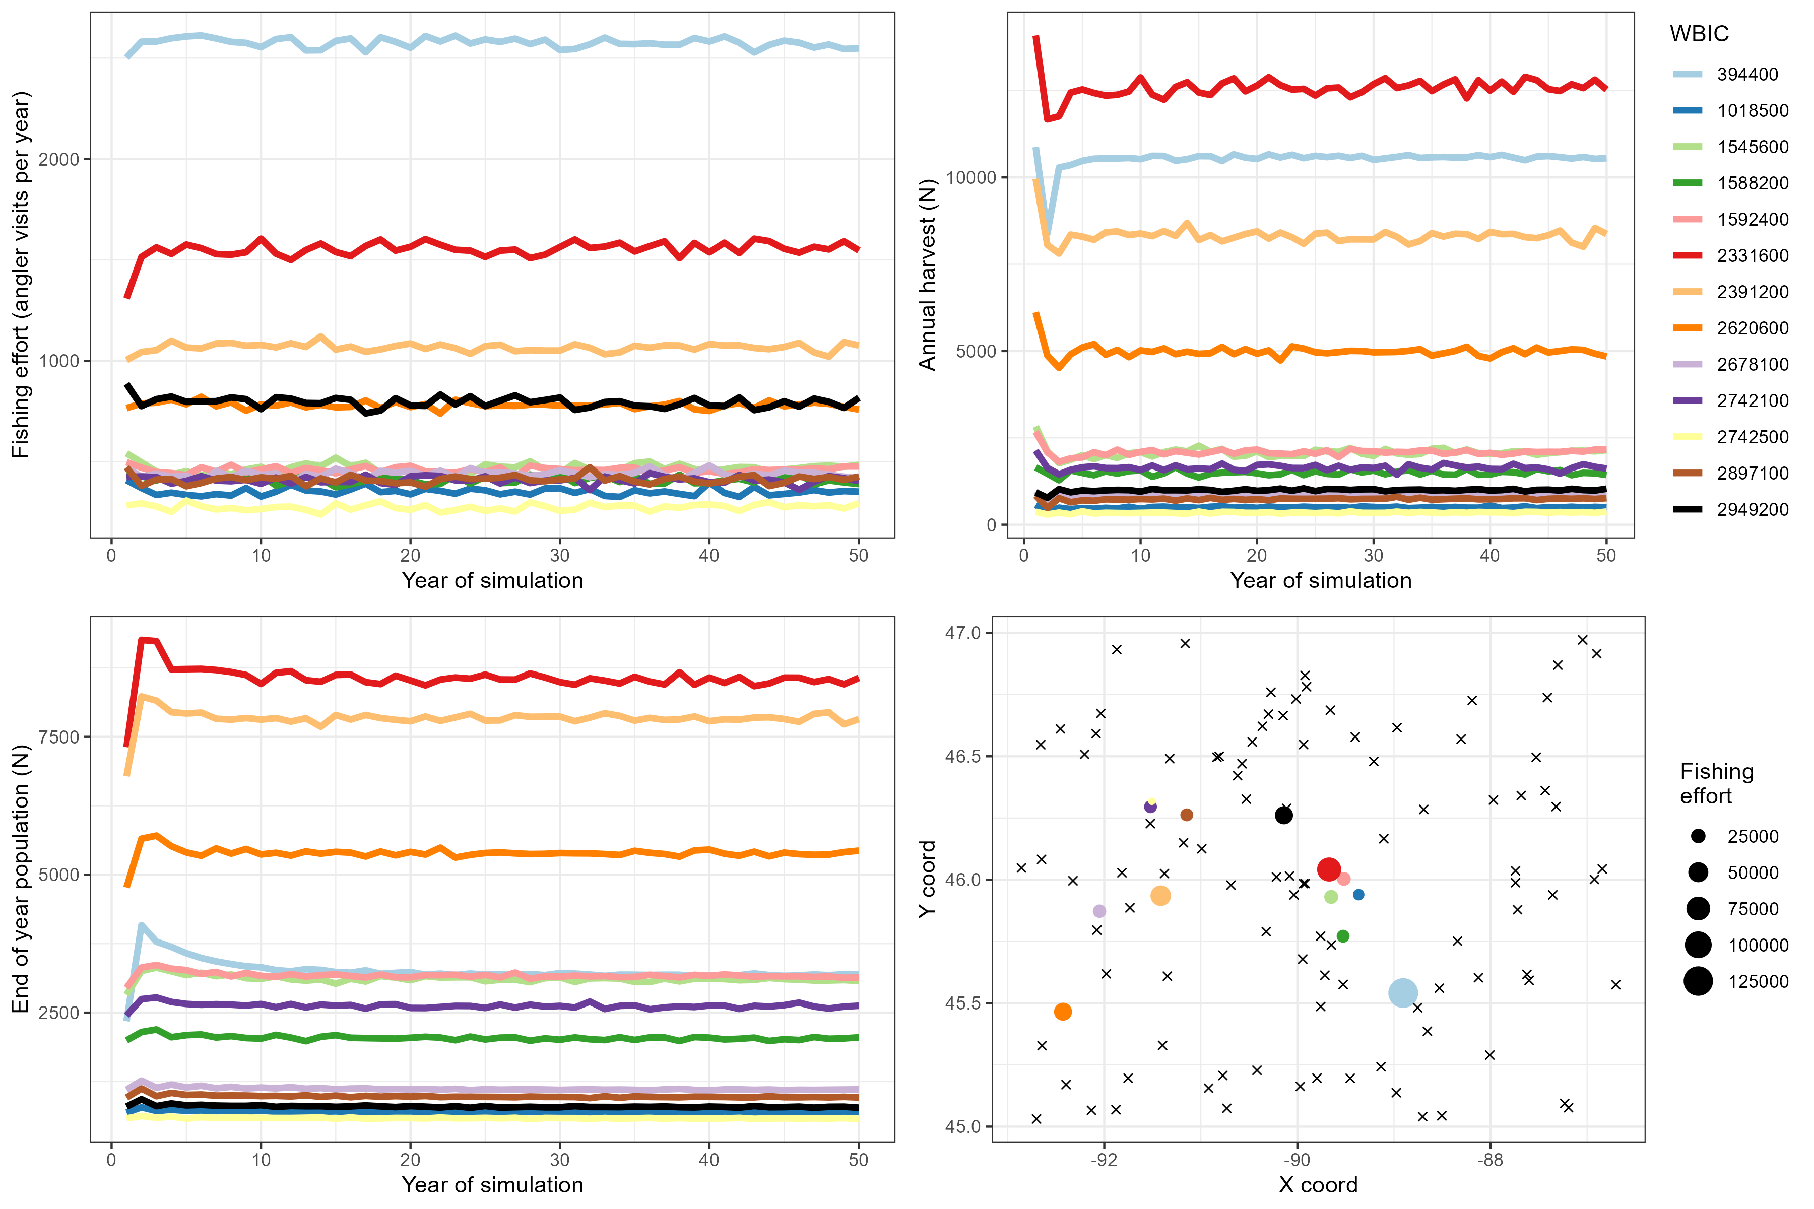
Fishing effort (anglers/year)
Annual harvest (N)
Walleye population (N)
Notes:
And here we have plots tracking annual fishing effort, harvest, and walleye abundance. And in the bottom right, a map of the lakes’ locations (colorded dots) and those of the anglers, which were randomly placed in this box. And one thing that’s really evident is that location is driving these patterns. The blue lake is attracting the most fishing effort, not because it has a high walleye population, but because it’s the closest lake ot the most anglers. So this tells me that getting the spatial distribution of anglers and lakes correct is going to be important, as will using informed estimates of angler tradeoffs between travel and fishing quality.

Slide 14
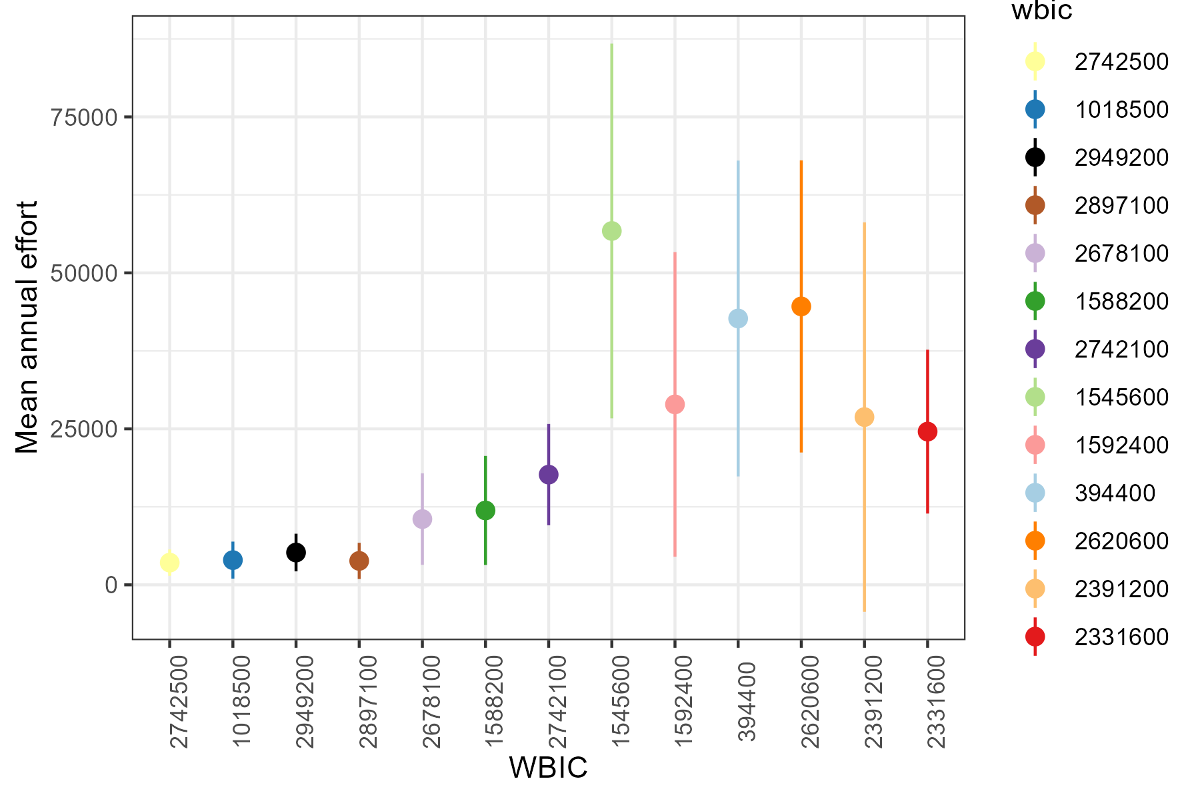
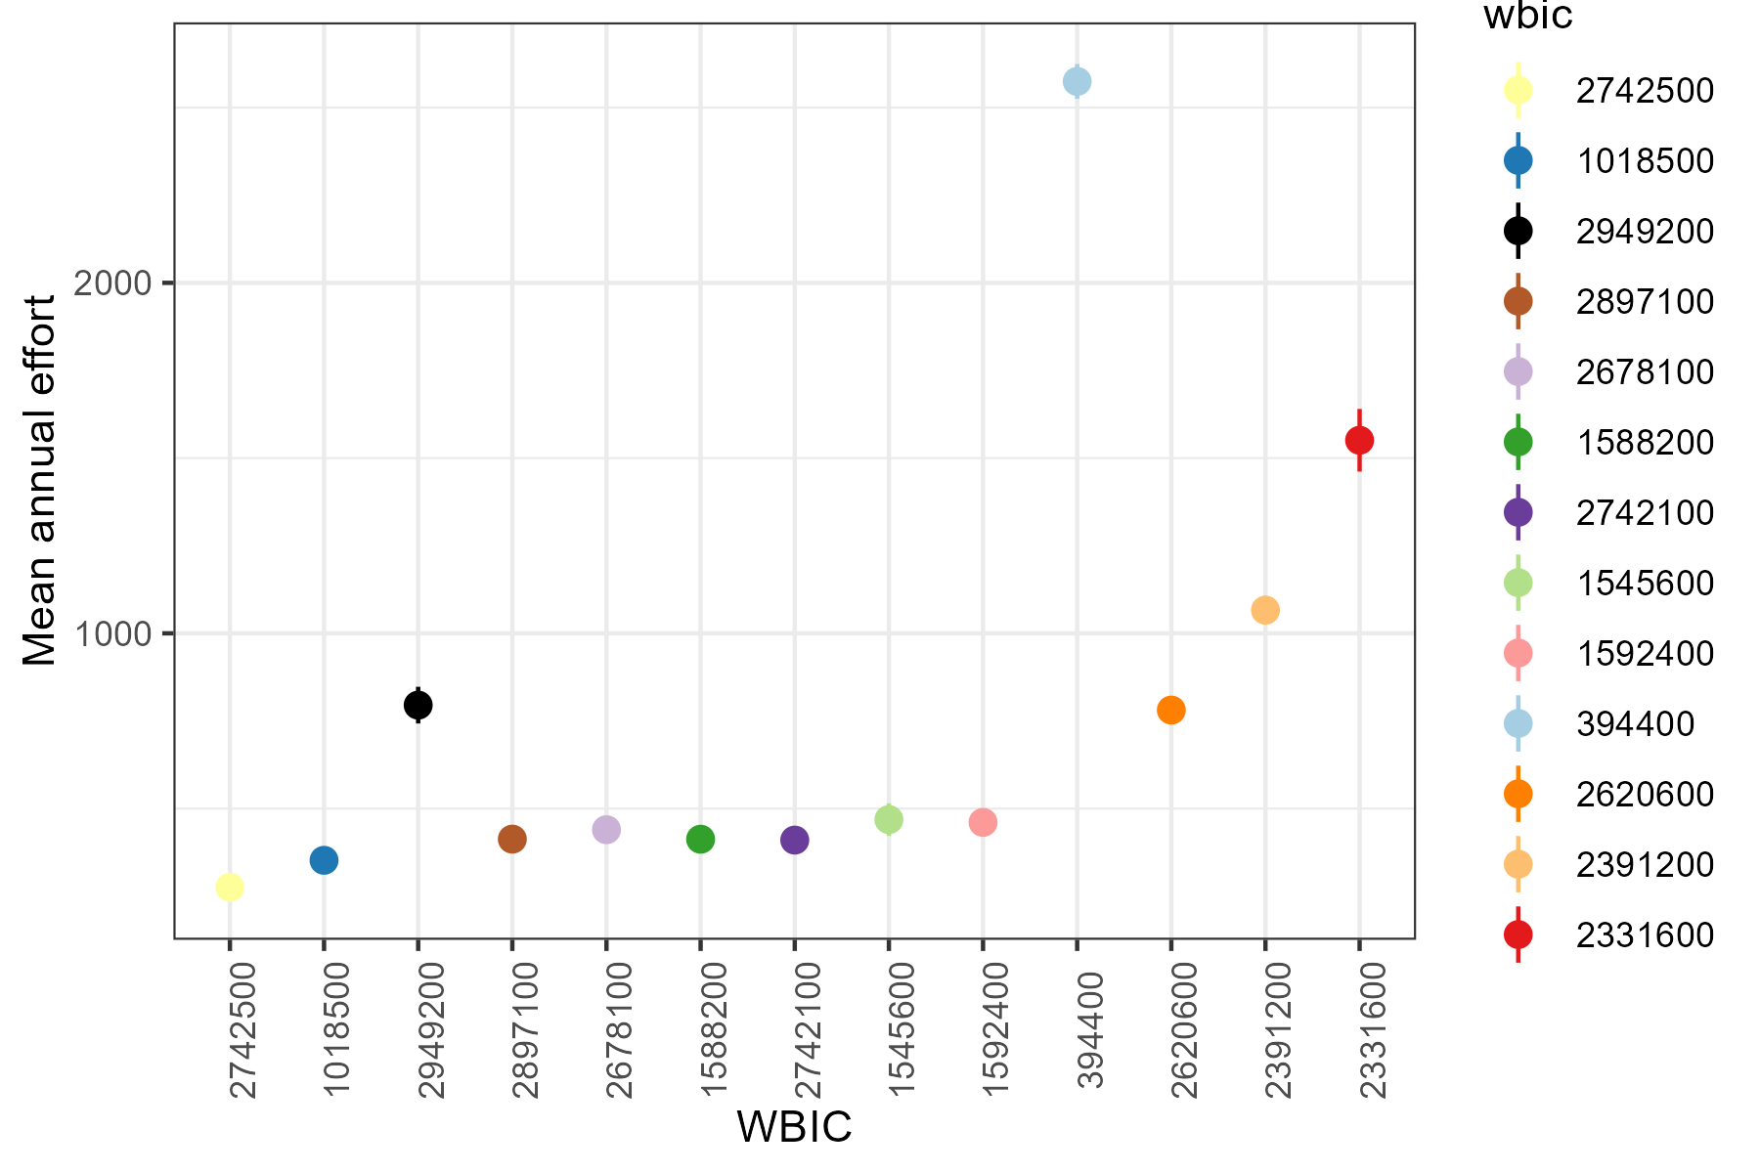
Pattern matching—compare model outputs to observations
Reality:
Simulation:

Slide 15
Status
ABM: on github, in time-out for a year
Catchability paper: Drafted, with coauthors
Use: Empirical distributions of the effects of angler, date, and population density on catch
Choice experiment: Completed, submitted, torn to shreds by reviewers. Possibly useless
Use: Utilities of catch rates and size for walleye, bass, bluegill, incl tradeoffs between species. (But, nonrepresentative responses, so use with care)
Revealed preference analysis of angler diaries: on github. Predicting participation and waterbody type by age, gender, residence
Use: Simulating angler participation? (And dealing with non-lake fishing options) Anglers choosing to 1) not fish, 2) fish great lakes, 3) fish rivers, 4) fish inland lakes. Inland lake anglers then go through the rest of the simulation.
Notes:
Chtc website: https://chtc.cs.wisc.edu/

